Slide 1
Legalization & Decriminalization

Slide 2
The Trend
In the last decade, there has been greater movement by people and government to soften the punishment for drug users, with a focus on marijuana
Why?
Cost of incarceration/enforcement have increased dramatically
Increasing acceptance of Marijuana use
Harshly punishing simple possession does not help people with addiction problems

Slide 3
There are a number of options that States/Countries can do this through the law. In general they can be classified into two categories:
Legalization (합법화)
Decriminalization (비범죄화)
(These words may seem to mean the same thing, but in this case they are very different!)

Slide 4
Legalization
Definition: The act of making something previously illegal permissible by law
Illegal→Legal
This is done by changing the statutory law directly.

Slide 5
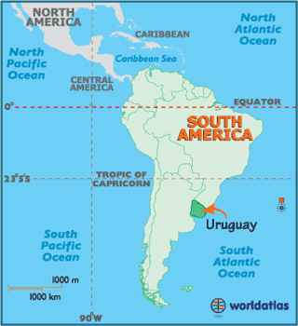
Legalization - Uruguay

Slide 6
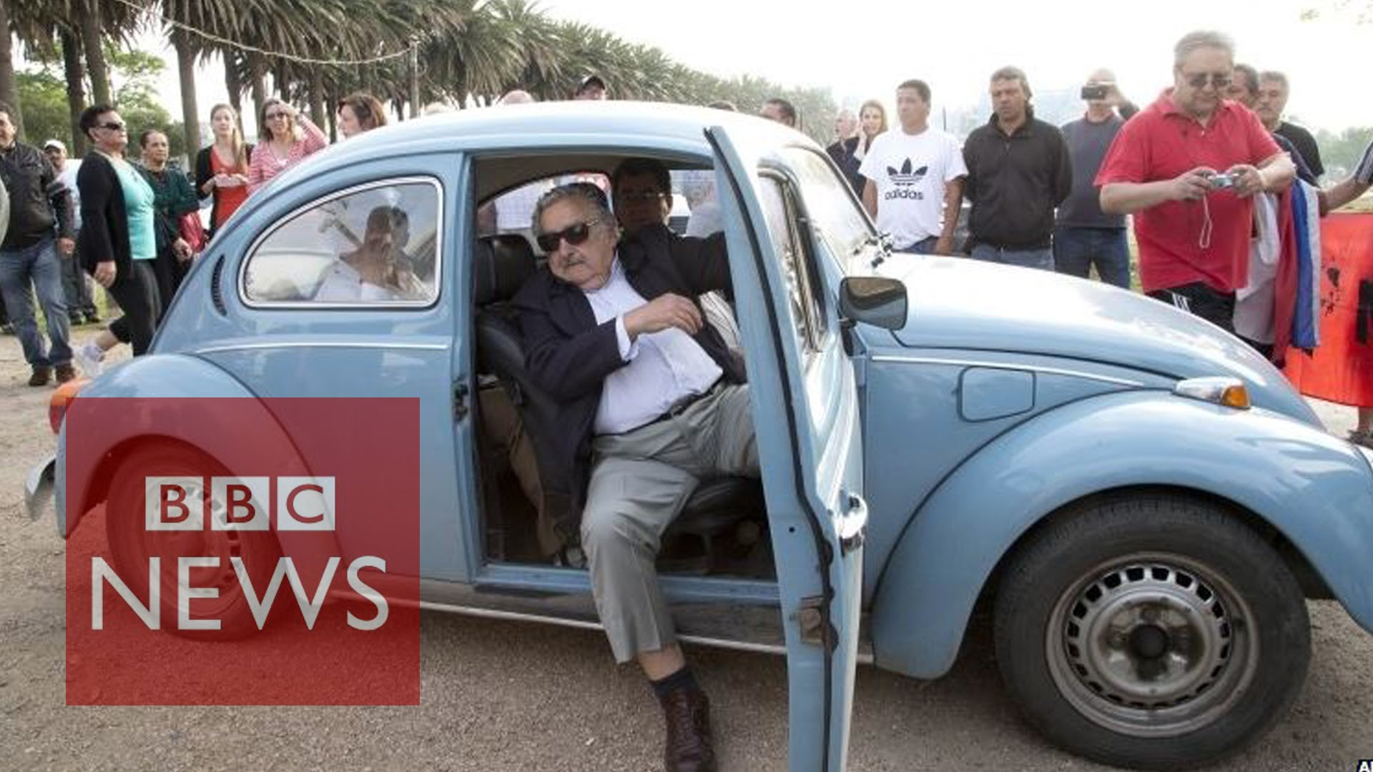
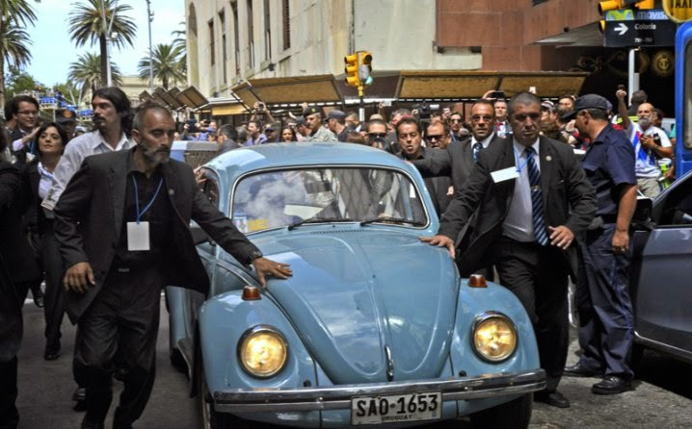
Legalization - Uruguay
In 2013, Uruguay, under the leadership of then-president Jose Mujica, fully legalized marijuana within the entire country.

Slide 7
Legalization - Uruguay
Legal BUT highly regulated by the government:
Individuals can purchase up to 40 grams of the drug (10 grams per week, according to the regulations) in licensed pharmacies with or without a prescription, which is to be produced by a handful of commercial growers who are specifically approved by the state to do so. To access the drug, users must first register with the [Government].
Users can grow plants for their own consumption, so long as they have first registered their plants with the [Government].
The [Government] oversees every step of the cannabis production chain, from seed to sale. Commercial cultivators will be contracted directly by the state to produce the drug, which can only be sold in licensed pharmacies.

Slide 8
What about Single Convention 61?
Uruguay is a party to the Single Convention on Narcotics 1961 (signing on in 1975
See http://www.incb.org/documents/Publications/PressRelease/PR2013/press_release_111213.pdf

Slide 9
More Problems
Major International Banks of the United States started to refuse to do business with Uruguayan companies associated with the Marijuana business
Reason: It is illegal under US law for US banks to conduct transactions for dealers of certain controlled substances (including marijuana), including the profits
If a U.S. bank accepts a deposit from a Uruguayan company engaged in selling marijuana, that U.S. bank could be criminally liable for money laundering.
In addition, the same applies if U.S. bank does business with any Uruguayan bank that does business with those dealers.

Slide 10
Legalization 2018
September 2018 – South Africa’s Supreme Court legalized private use and growing of marijuana
Using in public or selling is still illegal
AND in June 2018, Canada passed a law to make recreational marijuana completely legal on . . . October 17 (in one week!)

Slide 11
Decriminalization
Dictionary Definition:
”to remove or reduce the criminal classification or status of; especially : to repeal a strict ban on while keeping under some form of regulation”

Slide 12
Decriminalization of Drugs
We will look at two different methods that have been used to “decriminalize” drugs in two countries—Portugal and Netherlands
These countries exploit the legal “gap” in international law when it comes specifically to drug possession.

Slide 13
Article 4:
[T]o limit exclusively to medical and scientific purposes the production, manufacture, export, import, distribution of, trade in, use and possession of drugs
Article 36 (Penal Possession):
[E]ach Party shall adopt such measures as will ensure that cultivation, production, manufacture, extraction, preparation, possession, offering, offering for sale, distribution, purchase, sale, delivery on any terms whatsoever, brokerage, dispatch, dispatch in transit, transport, importation and exportation of drugs . . . shall be punishable offences

Slide 14
“formal” decriminalization - Portugal
In 2001, Portugal enacted comprehensive decriminalization of possession of ALL illicit drugs.
The law maintains possession of drugs as illegal. However, the law states tha possession does not trigger criminal penalties.
A person found in possession of personal-use amounts of any drug in Portugal will not be punished criminally, but rather ordered to appear before a local “dissuasion commission”. The commission can refer that person to a voluntary treatment program, pay a fine or impose other administrative sanctions.
Drug trafficking offenses remain illegal and are still processed through the criminal justice system.

Slide 15
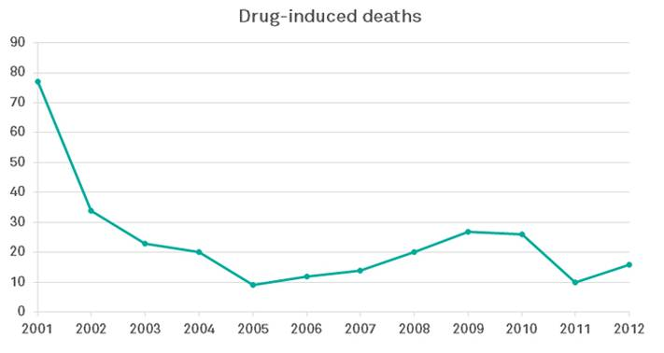

Slide 16
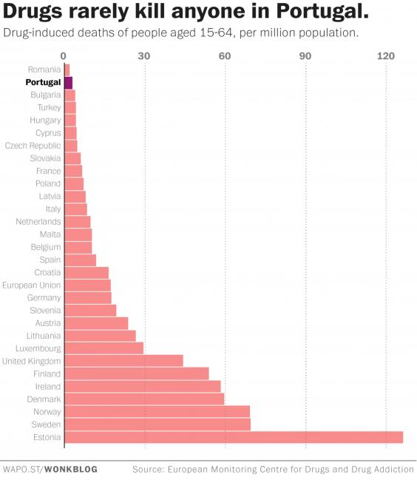

Slide 17
“Informal” Decriminalization –Netherlands
In the Netherlands, all drug possession is technically illegal. The statute has not been altered.
However, the law distinguishes between “soft” and “hard” drugs.
Soft drugs are enforced under a “Tolerance” policy (gedoogbeleid)
For example, simple possession of less than 5 grams of marijuana will not be criminally prosecuted. Drugs are seized
Larger amounts/multiple offenses may result in a fine or community service (or prison sentence)
This policy is established by the Prosecutor General as a directive (internal order)
How prosecutors should treat certain drug cases.
Large-scale dealing, production, import and export of drugs is still completely illegal and subject to criminal prosecution.

